Slide 1
IMT 542 GitHub User Analysis Project
Name: Xinyi (Eve) Wang

Slide 2
Overview
Info story or who is the user and why is it important to them
Existing structure and FAIR assessment
How you decided to improve the structure
What your new structure is
How would quality be identified and addressed

Slide 3
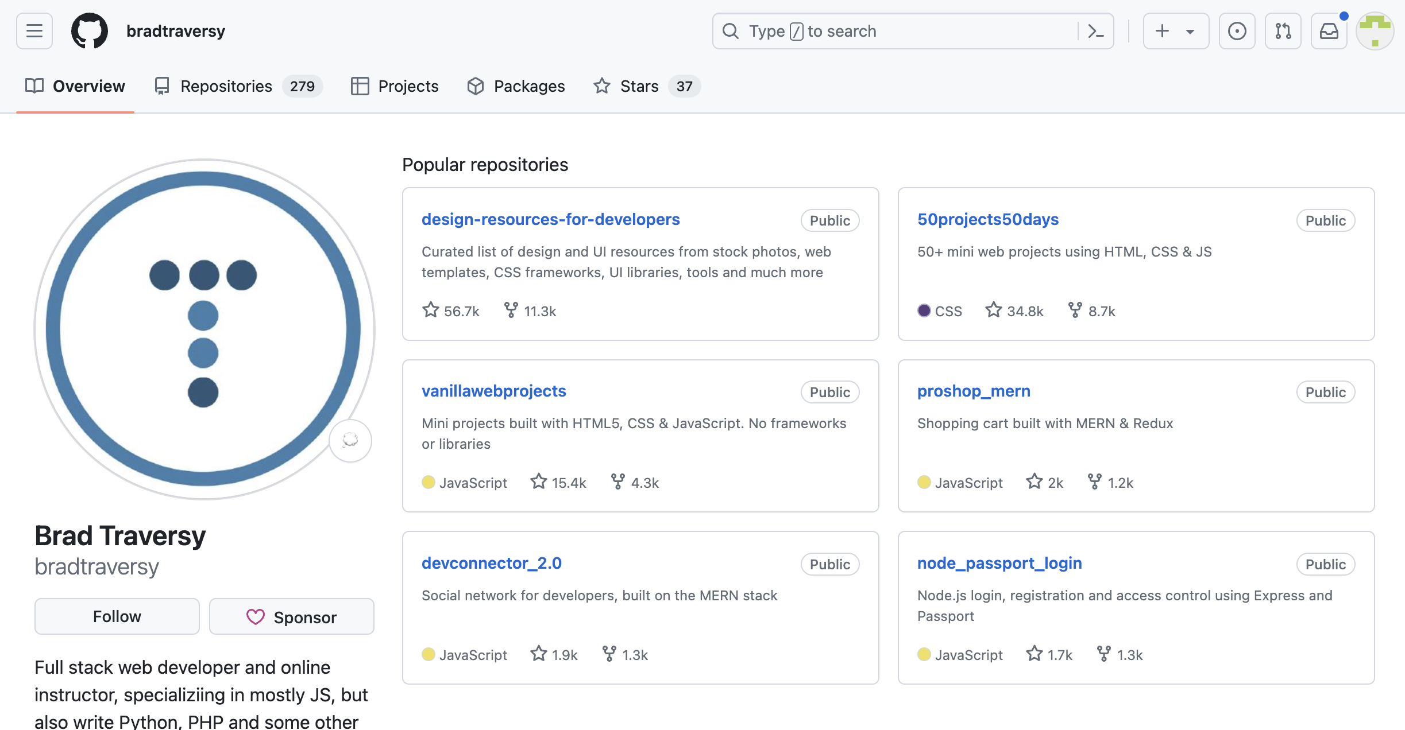
Info story
Recruiters - > Candidate’s GitHub
- > in 2 minutes, determine: Are you a proficient Java developer? How good are you?
Problem:
Too much information
Difficult to generate insights on candidates
in a uniform manner

Slide 4
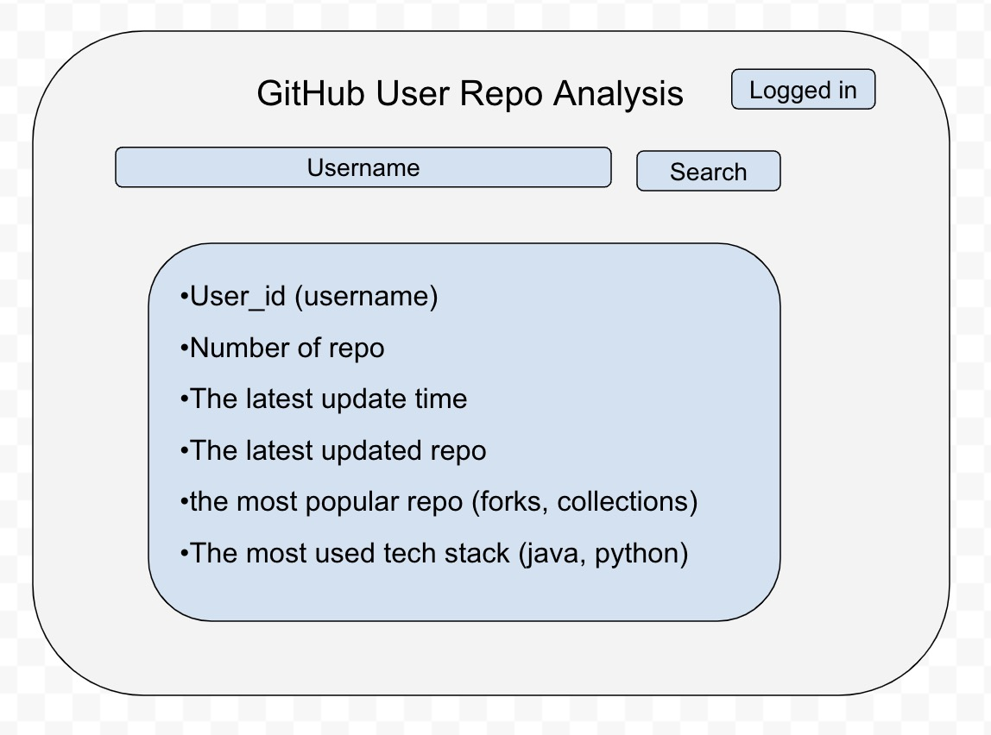
Info story
Solution: Automated GitHub user analysis
Retrieving data available on the GitHub webpage
Filtering useful information for recruiters
Analyze and add new fields with additional insights
Summarize the user and repo insights
Help recruiters find candidates with the right skillsets
Information wireframe

Slide 5
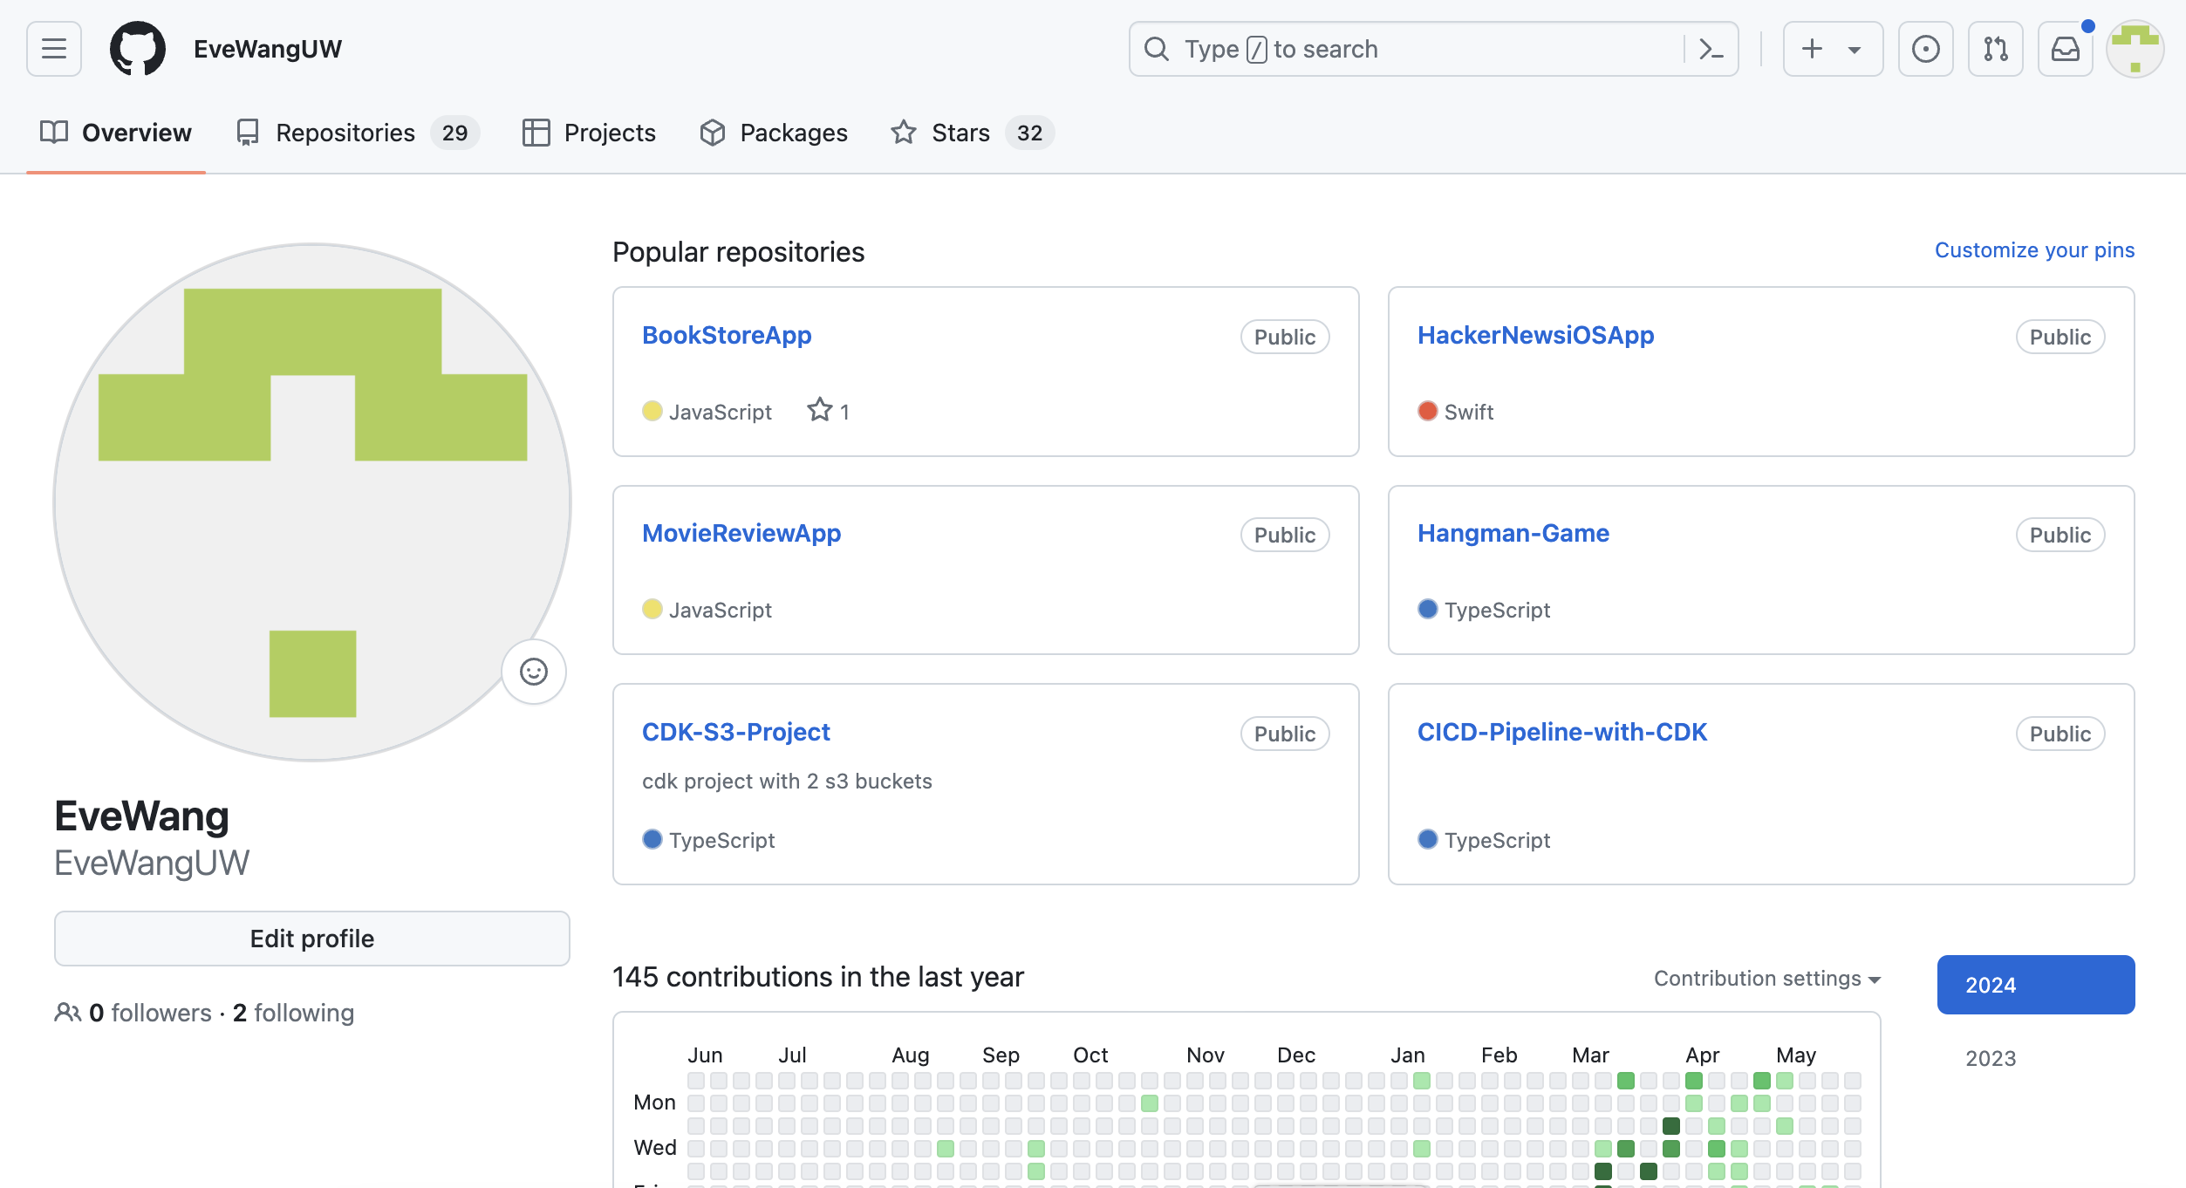
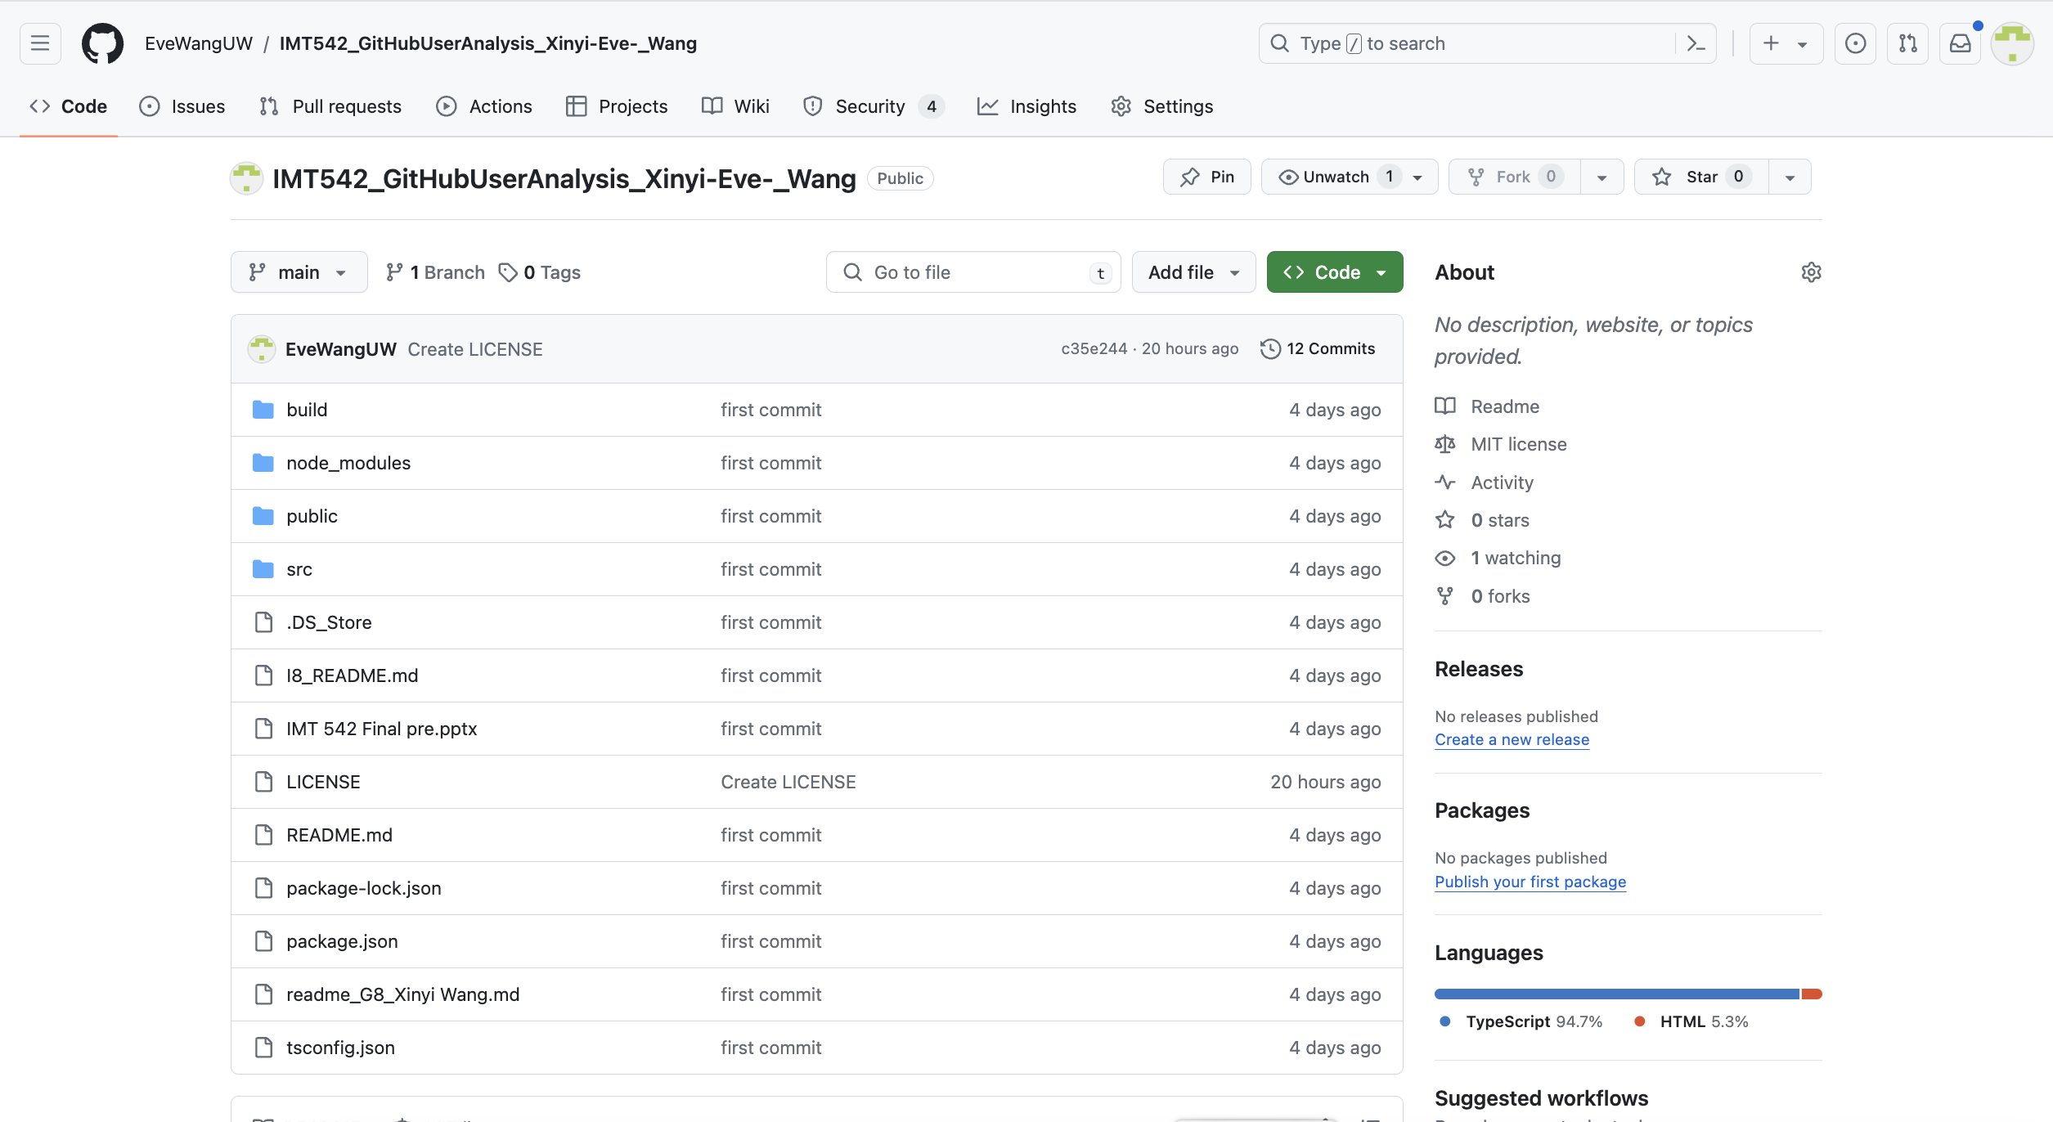
Existing structure and FAIR assessment
Existing structure from GitHub web page

Slide 6
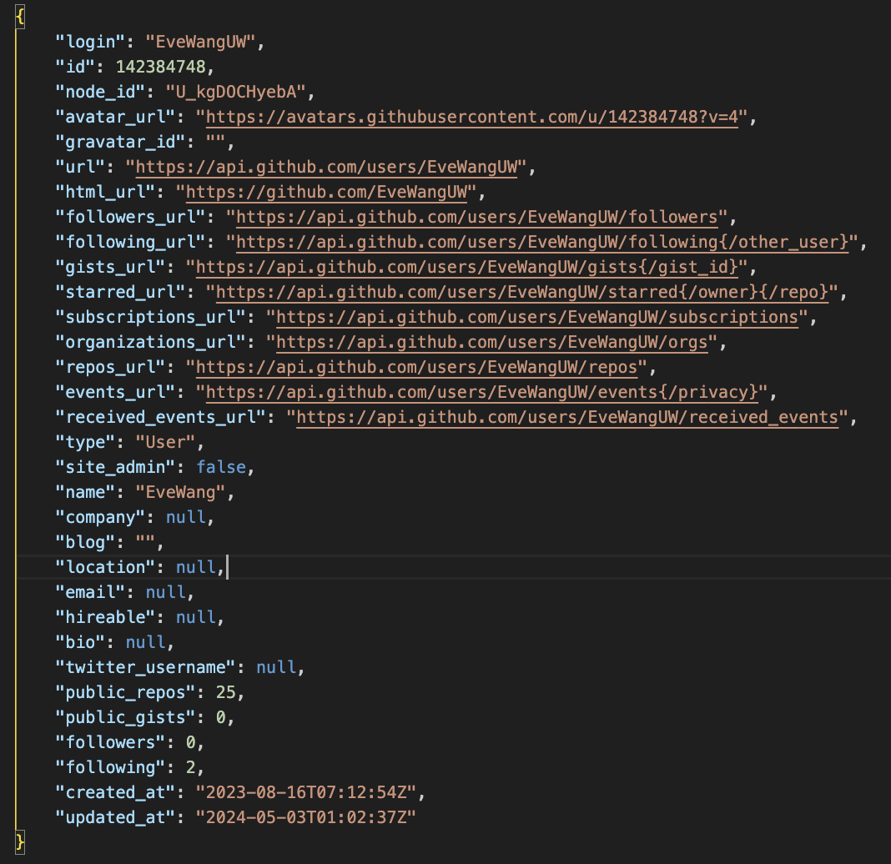
Existing structure and FAIR assessment
Existing structure from
GitHub REST API endpoints
1. User information

Slide 7
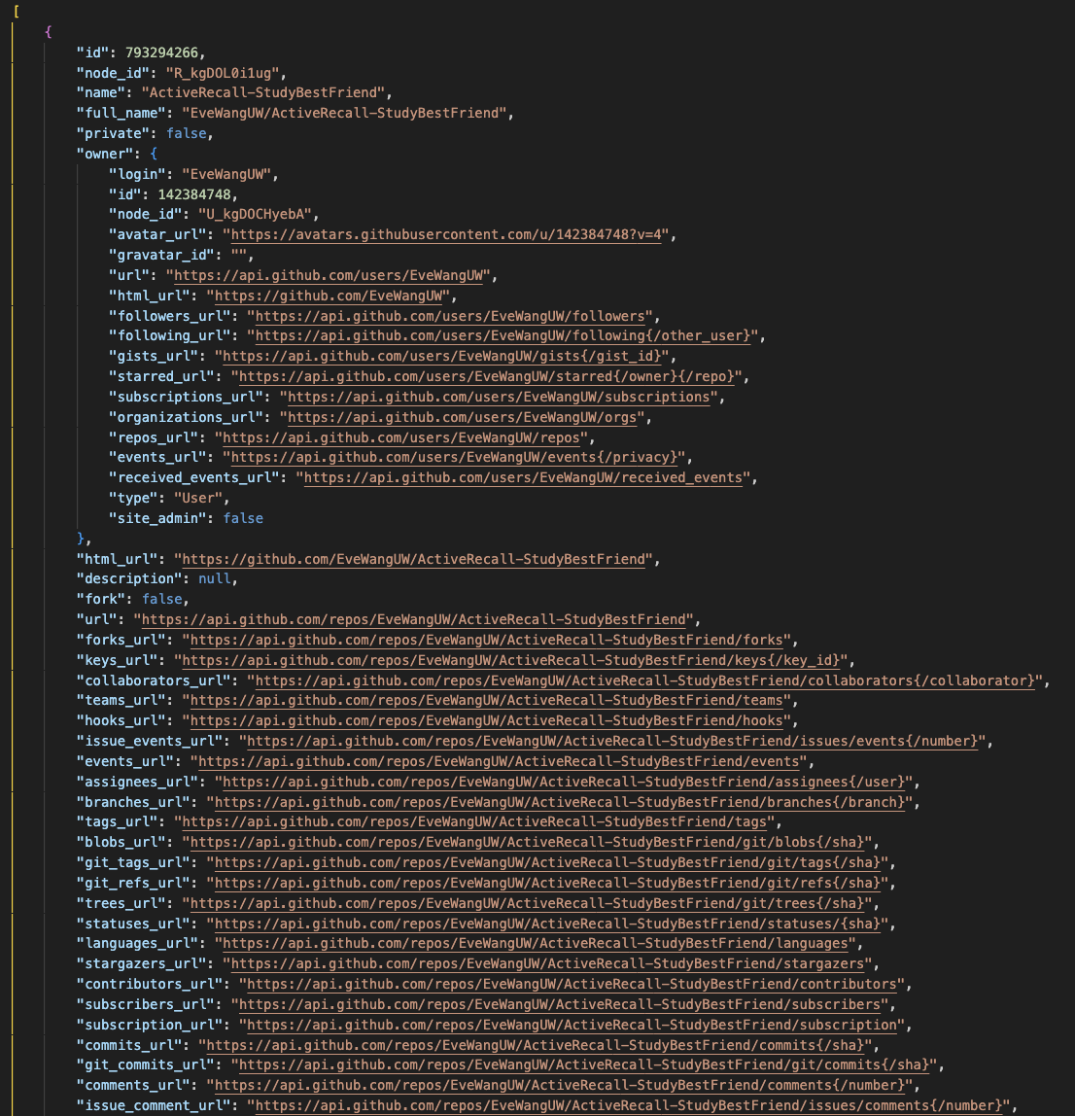
Existing structure and FAIR assessment
Existing structure from
GitHub REST API endpoints
2. User repo information

Slide 8
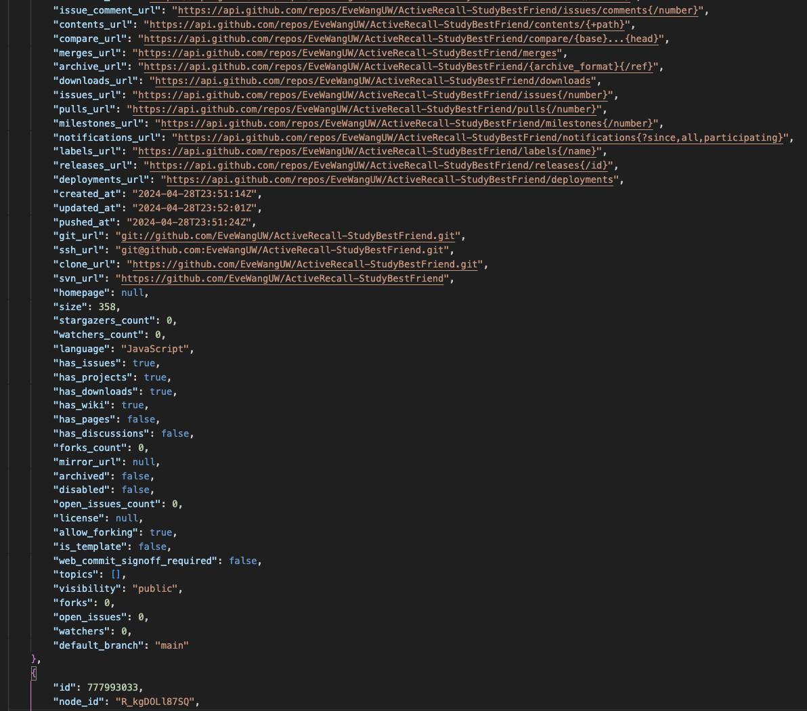
Existing structure and FAIR assessment
Existing structure from
GitHub REST API endpoints
2. User repo information

Slide 9
Existing structure and FAIR assessment
FAIR assessment - GOOD:
F1: Both the user data and the user repo data have globally unique identifiers such as login and id.
F3: The metadata clearly and explicitly include the identifier of the data they describe for example, both the user and repo data include URLs to various resources such as ‘followers_url’ and ‘commits_url’.
F2: There is also rich metadata on the user and repository details, such as ‘updated_at’, ‘created_at’, profile URLs, and owner details
A1, A1.1: The data are retrievable via standardized, open, and free APIs provided by GitHub.
I1: These data use the JSON language format, which is a formal, accessible, shared, and broadly applicable language for knowledge representation
I3: the various URLs included in the user and the repo data direct the users to related
resources, for example, the repo data includes the repo owner’s information

Slide 10
Existing structure and FAIR assessment
FAIR assessment – deficiencies that need to be improved
A2: if the user account or the repo is deleted, the metadata might not be accessible anymore, which may not conform to the A2 principle.
R1: In terms of re us ability, although rich attributes are provided, some of the attributes are not relevant to our recruiters, such as ‘avater_url’, ‘is_template’，not conforming to R1
R1.1: In the user and user repo, most of the data lack license information, not conforming to the R1.1.
R1.2: Finally, although time related attributes such as ‘updated_at’, ‘created_at’ provide some provenance information, but more details could be included to achieve the R1.2 principle.

Slide 11
Existing structure and portability assessment
Portability assessment – deficiencies that needs to be improved
Clean meaning: raw JSON with too much info and lack of summary
Accessibility: look at the page directly or make API calls
Transparency: difficulty understanding the field
Interoperability: JSON format only, may not work well on mobile devices.
Usability: difficult to use directly for candidate assessment
Structure: lack of summary and structure

Slide 12
How you decided to improve the structure
To improve accessibility (A),
1. implement a backup system to retain metadata even if the user account or repo is deleted, which can be accomplished by allowing the user to download the data from the web application
To improve reusability (R),
1. Remove unnecessary attributes like ‘avator_url’ and focus on displaying information related to recruiters.
2. Add relevant license for this application
3. Add more analytics details and provenance information to provide recruiters with useful insights into candidate profiles.

Slide 13
How you decided to improve the structure
Portability improvement:
Clean meaning:
raw JSON with too much info and lack of summary -> summary of insights
Accessibility:
look at the page directly or make API calls -> interactive frontend to present the analysis result + provide downloadable data
Transparency:
difficulty understanding the field -> detailed explanation documentation

Slide 14
How you decided to improve the structure
Portability improvement:
Interoperability:
JSON format only, may not work well on mobile devices -> typescript for typing and data schema, React for interoperability on web and mobile, more data format such as CSV
Usability:
difficult to use directly for candidate assessment -> analyze based on raw data and generate deeper insights on the user and their repos
Structure:
lack of summary and structure -> combine user and repo insights in one JSON file

Slide 15
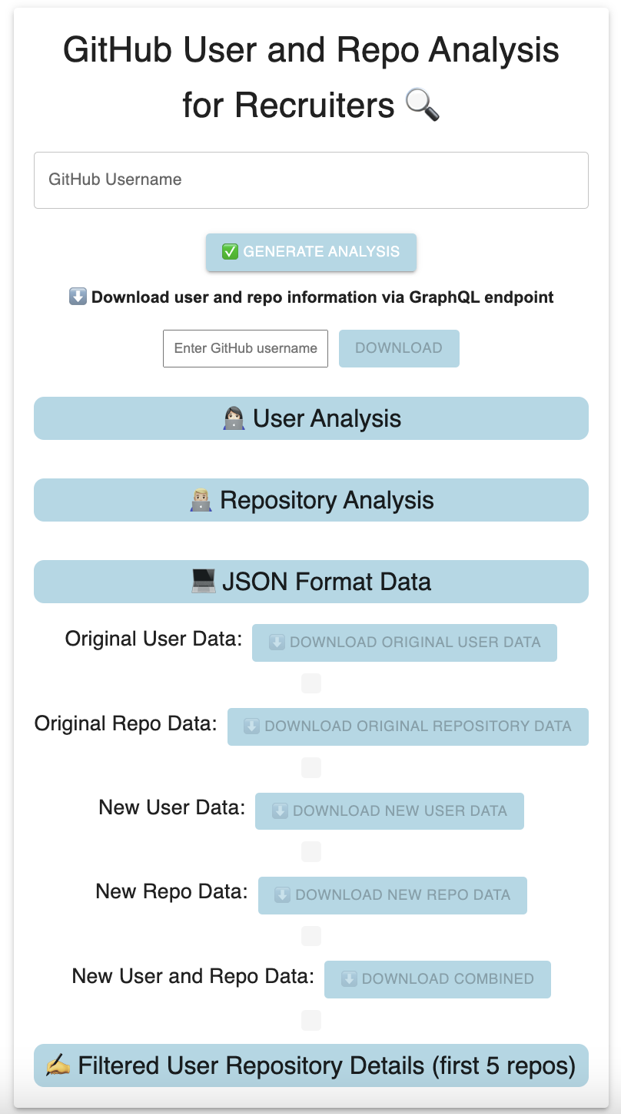
What your new structure is
GitHub User and Repo Analysis for Recruiters (hosted on Amazon S3)
http://githubanalysiseve.s3-website-ap-southeast-2.amazonaws.com/

Slide 16
What your new structure is
Information itself:
Existing information structure:
too much information
New information structure:
1. Information has been trimmed
-> retain information that is useful to recruiters in analyzing a candidate's programming skill level.
2. Added new fields: e.g.: the time of the user on GitHub
-> analyzed and summarized information from the user account and all the repositories’ information.

Slide 17
What your new structure is
Structure/format:
Existing information structure:
raw JSON data directly retrieved from the GitHub API, includes overall details fields that may not be relevant to the recruiters (e.g. node IDs or avatar URLs)
New information structure:
filtered and summarized data that includes only relevant fields (e.g. user name, repository name)
and additional computed fields (e.g. total time the user has been on GitHub and fields about their programming skill levels)
-> providing more relevant information to the recruiters.

Slide 18
What your new structure is
Access methodology:
Existing information structure:
Directly access the GitHub webpage
Manual API calls
New information structure:
Web application hosted on Amazon S3
GraphQL API calls
REST API calls

Slide 19
How would quality be identified and addressed
Lasting change:
- Provide downloadable original and new information structure
Durable and Robust Application:
- Apply rigorous unit-testing, including:
Sending requests - > Hitting the GitHub API endpoint
Getting responses -> Rendering components on the frontend based on responses
- Use TypeScript unit-testing frameworks with a goal of achieving 99%+ test coverage.
Application and data security
Use an MIT license for the code to ensure open-source accessibility.
The application is hosted on Amazon S3 bucket for security

Slide 20
Q & A
Thank you! :)

